Slide 1
ECE 424 – Introduction to VLSI
Emre Yengel
Department of Electrical and Communication Engineering
Fall 2014

Slide 2
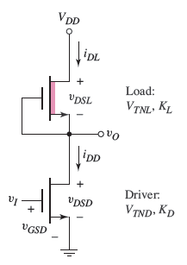
Q & A
In the depletion-load NMOS inverter circuit, let V_{T ND} = 0.5 V and V_{DD} = 3 V, K_{L} = 50 μA/V², and K_{D} = 500 μA/V². Calculate the value of V_{T NL} such that v_{O} = 0.10 V when v_{I} = 3 V.

Slide 3
Q & A
Consider the NMOS inverter with depletion load in Figure 16.7(a). Let V_{DD} = 1.8 V, and assume V_{T ND} = 0.3 V and V_{T NL} = −0.6 V. (a) Design the circuit such that the power dissipation is 80μW and the output voltage is v_{O} = 0.06 V when v_{I} is a logic 1. (b) Using the results of part (a), determine the transition points for the driver and load transistors. (c) If (W/L)_{D} found in part (a) is doubled, what is the maximum power dissipation in the inverter and what is v_{O} when v_{I} is a logic 1?

Slide 4
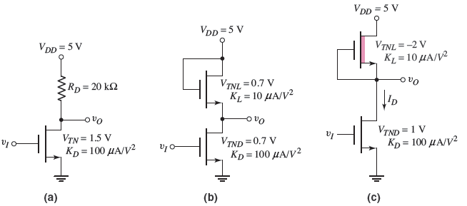
Q & A
Calculate the power dissipated in each inverter circuit in Figure below for the following input conditions: (a) Inverter a: (i) v_{I} = 0.5 V, (ii) v_{I} = 5 V; (b) Inverter b: (i) v_{I} = 0.25 V, (ii) v_{I} = 4.3 V; (c) Inverter c: (i) v_{I} = 0.03 V, (ii) v_{I} = 5 V.

Slide 5
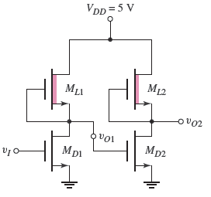
Q & A
Consider the circuit in Figure below. The parameters of the driver transistors are V_{T ND} = 0.8 V and (W/L)_{D} = 4, and those of the load transistors are V_{T NL} = −1.2 V and (W/L)_{L} = 1. (a) If v_{I} is a logic 1, determine the values of v_{O1} and v_{O2}. (b) Repeat part (a) if v_{I} is a logic 0.

Slide 6
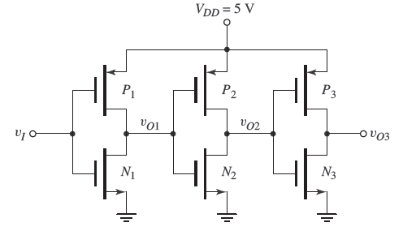
Q & A
Consider the series of CMOS inverters in Figure below. The threshold voltages of the n-channel transistors are V_{T N} = 0.8 V, and the threshold voltages of the p-channel transistors are V_{T P} = −0.8 V. The conduction parameters are all equal. (a) Determine the range of v_{O1} for which both N₁ and P₁ are biased in the saturation region. (b) If v_{O2} = 0.6 V, determine the values of v_{O3}, v_{O1}, and v_{I} .

Slide 7
Q & A
(a) A CMOS inverter is biased at V_{DD} = 2.5 V. The transistor parameters are K_{n} = K_{p} = 120μA/V², V_{T N} = 0.4 V, and V_{T P} = −0.4 V. Calculate the current in the transistors as a function of the input voltage for 0 ≤ v_{I} ≤ 2.5 V. (b) Repeat part (a) for V_{DD} = 1.8 V and 0 ≤ v_{I} ≤ 1.8 V.

Slide 8
Q & A
A CMOS inverter is biased at V_{DD} = 3.3 V. The transistor threshold voltages are V_{T N} = +0.4 V and V_{T P} = −0.4 V. Determine the peak current in the inverter and the input voltage at which it occurs for (a) (W/L)_{n} = 3, (W/L)_{p} = 7.5; (b) (W/L)_{n} = (W/L)_{p} = 4; (c) (W/L)_{n} = 3, (W/L)_{p} = 12. (k’_{n} = 50 and k’_{p} =20)

Slide 9
Q & A
(a) A CMOS digital logic circuit contains the equivalent of 4 million CMOS inverters and is biased at V_{DD} = 1.8 V. The equivalent load capacitance of each inverter is 0.12 pF and each inverter is switching at 150 MHz. Determine the total average power dissipated in the circuit. (b) If the switching frequency is doubled, but the total power dissipation is to remain the same with the same load capacitance, determine the required bias voltage.

Slide 10
Q & A
A particular IC chip can dissipate 3 W and contains 10 million CMOS inverters. Each inverter is being switched at a frequency f . (a) Determine the average power that each inverter can dissipate without exceeding the total allowed power. (b) If the switching frequency is f = 5 MHz, what is the maximum capacitive load on each inverter if (i) V_{DD} = 5 V, (ii) V_{DD} = 3.3 V, and (iii) V_{DD} = 1.5 V.

Slide 11
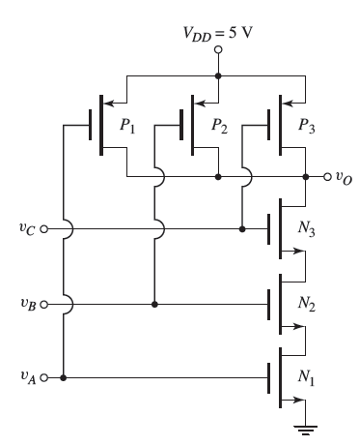
Q & A
Consider the three-input CMOS NAND circuit in Figure below. Assume k’_{n} = 2k’_{p} and V_{T N} = | V_{T P} | = 0.8 V. (a) If v_{A} = v_{B} = 5 V, determine v_{C} such that both N₃ and P₃ are biased in the saturation region when 2(W/L)_{n} = (W/L)_{p} . (State any assumptions you make.) (b) If v_{A} = v_{B} = v_{C} = v_{I} , determine the relationship between (W/L)p and (W/L)n such that v_{I} = 2.5 V when all transistors are biased in the saturation region. (c) Using the results of part (b) and assuming v_{A} = v_{B} = 5 V, determine v_{C} such that both N₃ and P₃ are biased in the saturation region. (State any assumptions you make.)

Slide 12
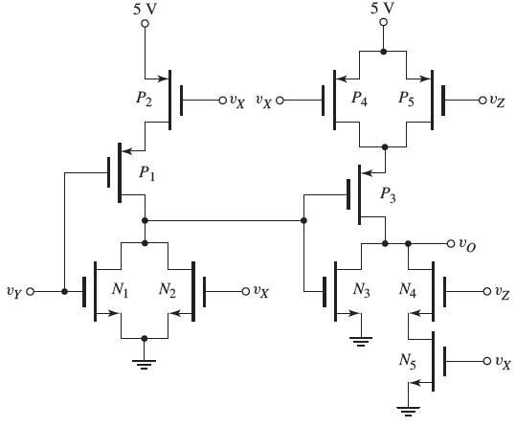
Q & A
Consider the circuit in Figure below. (a) The inputs v_{X} , v_{Y} , and v_{Z} listed in the following table are either a logic 0 or a logic 1. These inputs are the outputs from similar-type CMOS logic circuits. The input logic conditions listed are sequential in time. State whether the transistors listed are “on” or “off,” and determine the output voltage. (b) What logic function does this circuit implement?

Slide 13
Q & A
Consider a four-input CMOS NOR logic gate. Determine the W/L ratios of the transistors to provide for symmetrical switching based on the CMOS inverter design with (W/L)_{n}= 2 and (W/L)_{p}= 4. (b) If the load capacitance of the NOR gate doubles, determine the required W/L ratios to provide the same switching speed as the logic gate in part (a).

Slide 14
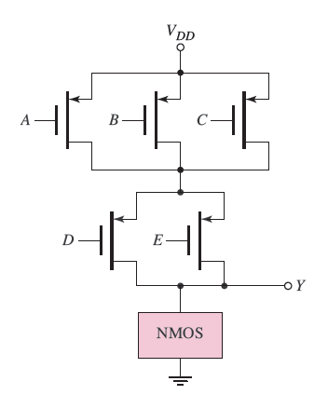
Q & A
Figure below shows a classic CMOS logic circuit. (a) What is the logic function performed by the circuit? (b) Design the NMOS network.

Slide 15
Q & A
(a) Given inputs A, B, C, A, B, and C , design a CMOS circuit to implement the logic function Y = A B C + A B C + A B C . The design should not include a CMOS inverter at the output.

Slide 16
Q & A
(a) Given inputs A, B, C, A, B, and C , design a CMOS circuit to implement the logic function Y = A B C + A B C + A B C . The design should not include a CMOS inverter at the output.

Slide 17
Q & A
(a) Given inputs A, B, C, A, B, and C , design a CMOS circuit to implement the logic function Y = A B C + A B C + A B C . The design should not include a CMOS inverter at the output.

Slide 18
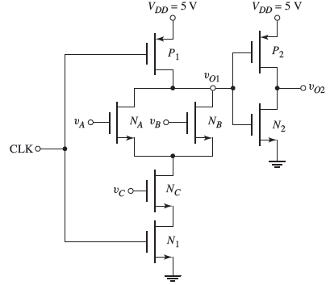
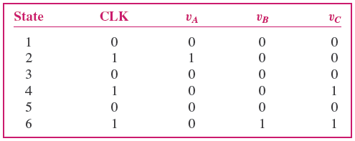
Q & A
(a) Figure below shows a clocked CMOS logic circuit. Make a table showing the state of each transistor (“on” or “off ”), and determine the output voltages v_{O1} and v_{O2} for the input logic states listed in the following table. Assume the input conditions are sequential in time from state 1 to state 6. (b) What logic function does the circuit implement?

Slide 19
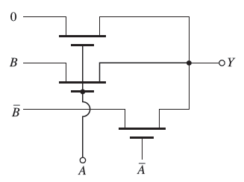
Q & A
Consider the circuit below. What logic function is implemented by this circuit? Are there any potential problems with this circuit?

Slide 20
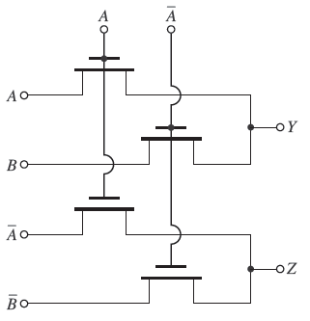
Q & A
What is the logic function implemented by the circuit in the Figure below?

Slide 21
Q & A
(a) Design an NMOS pass transistor logic circuit to perform the function Y = A + B(C + D). Assume that both the variable and its complement are available as input signals. (b) Repeat part (a) for the function Y = ABC + ABC.

Slide 22
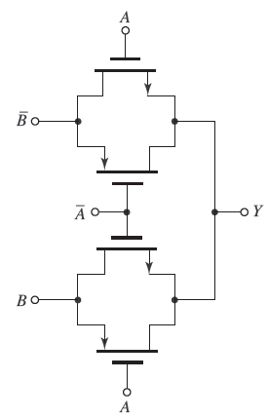
Q & A
Consider the circuit in the figure below. (a) Determine the value of Y for (i) A = B = 0; (ii) A = 2.5 V, B = 0; (iii) A = 0, B = 2.5 V; and (iv) A = B = 2.5 V. (b) What is the logic function implemented by the circuit?

Slide 23
Q & A
Which will have the greater resistance?
D
2D

Slide 24
Q & A
What is the minimum diameter (D) of the wire so that V < 1.5 V?
Cu wire
-
I = 2.5 A
+
V

