Slide 1
ECE 424 – Introduction to VLSI Design
Emre Yengel
Department of Electrical and Communication Engineering
Fall 2014

Slide 2
The Wire
Wiring of today’s integrated circuits has multiple effects on the circuit behavior;
1. An increase in propagation delay, or, equivalently, a drop in performance.
2. An impact on the energy dissipation and the power distribution.
3. An introduction of extra noise sources, which affects the reliability of the circuit.
First of all, a “complete” model is dauntingly complex and is only applicable to very small topologies.
Bringing all possible effects to bear, only obscures the picture and turns the optimization and design process a “trial-and-error” operation rather than an enlightened and focused search.
To achieve the latter, it is important that the designer has a clear insight in the parasitic wiring effects, their relative importance, and their models.

Slide 3
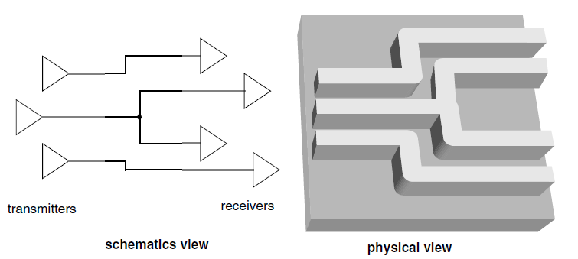
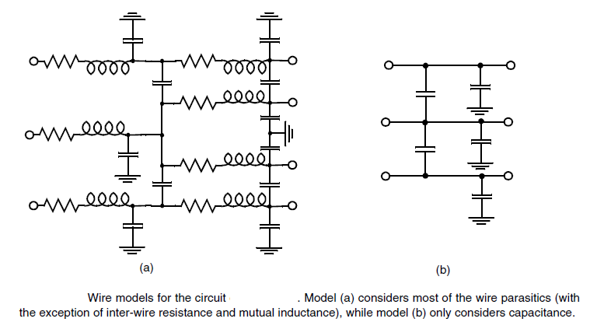
The Wire
This is best illustrated with
the simple example.
A full-fledged circuit model, taking into account the parasitic capacitance, resistance, and the inductance of the interconnections, is shown below.

Slide 4
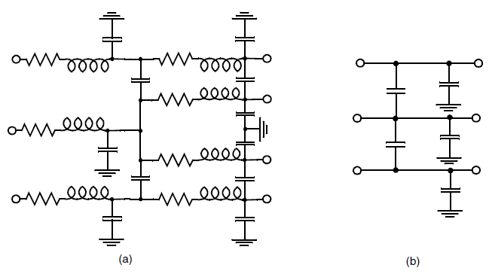
The Wire
Substantial simplifications can often be made, some of which are enumerated below.
• Inductive effects can be ignored if the resistance of the wire is substantial — this is for instance the case for long Aluminum wires with a small cross-section — or if the rise and fall times of the applied signals are slow.
• When the wires are short, the cross-section of the wire is large, or the interconnect material used has a low resistivity, a capacitance-only model can be used (Figure b).
• Finally, when the separation between neighboring wires is large, or when the wires only run together for a short distance, inter-wire capacitance can be ignored, and all the parasitic capacitance can be modeled as capacitance to ground.

Slide 5
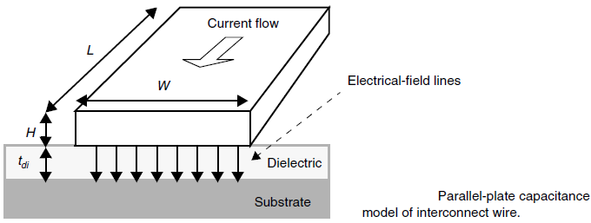
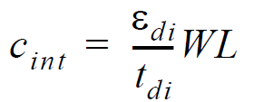
Interconnect Parameters - Capacitance
Rather than getting lost in complex equations and models, some simple first-order models come in handy to provide a basic understanding of the nature of interconnect capacitance and its parameters, and of how wire capacitance will evolve with future technologies.
Consider first a simple rectangular wire placed above the semiconductor substrate.
If the width of the wire is substantially larger than the thickness of the insulating material, it may be assumed that the electrical-field lines are orthogonal to the capacitor plates, and that its capacitance can be modeled by the parallel-plate capacitor model (also called area capacitance).
W and L are respectively the width and length of the wire, and t_{di} and ε_{di} represent the thickness of the dielectric layer and its permittivity.

Slide 6
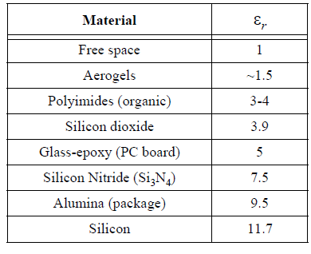
Interconnect Parameters - Capacitance
In actuality, this model is too simplistic.
To minimize the resistance of the wires while scaling technology, it is desirable to keep the cross-section of the wire (WXH) as large as possible.
On the other hand, small values of W lead to denser wiring and less area overhead.
As a result, we have over the years witnessed a steady reduction in the W/H-ratio, such that it has even dropped below unity in advanced processes.
Under those circumstances, the parallel-plate model assumed above becomes inaccurate.
The capacitance between the side-walls of the wires and the substrate, called the fringing capacitance, can no longer be ignored and contributes to the overall capacitance.

Slide 7
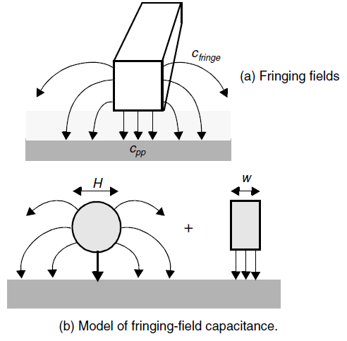
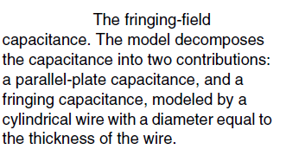
Interconnect Parameters - Capacitance
Use a simplified model that approximates the capacitance as the sum of two components; a parallel-plate capacitance
It is determined by the orthogonal field between a wire of width w and the ground plane, in parallel with the fringing capacitance modeled by a cylindrical wire with a dimension equal to the interconnect thickness H.

Slide 8
Interconnect Parameters - Capacitance
So far, we have restricted our analysis to the case of a single rectangular conductor placed over a ground plane.
This structure, called a microstripline, used to be a good model for semiconductor interconnections when the number of interconnect layers was restricted to 1 or 2.
Today’s processes offer many more layers of interconnect.
Inter-wire capacitances become a dominant factor in multi-layer interconnect structures.

Slide 9
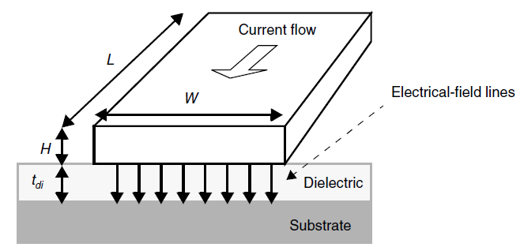
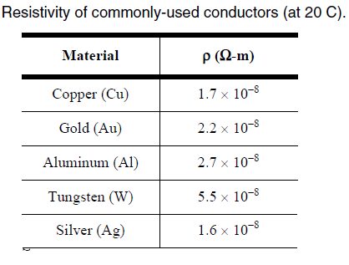
Interconnect Parameters - Resistance
The resistance of a wire is proportional to its length L and inversely proportional to its cross-section A.
The resistance of a rectangular conductor in the Figure can be expressed as
where the constant ρ is the resistivity of the material (in Ω-m).

Slide 10
Interconnect Parameters - Resistance
Since H is a constant for a given technology, Eq. (4.3) can be rewritten as follows,
with
the sheet resistance of the material, having units of W/□ (pronounced as Ohm-per-square).
At very high frequencies an additional phenomenon — called the skin effect — comes into play such that the resistance becomes frequency-dependent. High-frequency currents tend to flow primarily on the surface of a conductor with the current density falling off exponentially with depth into the conductor. The skin depth δ is defined as the depth where the current falls off to a value of e⁻¹ of its nominal value, and is given by
f the frequency of the signal and µ the permeability of the surrounding dielectric

Slide 11
Interconnect Parameters - Resistance
The increased resistance at higher frequencies may cause an extra attenuation — and hence distortion — of the signal being transmitted over the wire.
To determine the on-set of the skin-effect, we can find the frequency f_{s} where the skin depth is equal to half the largest dimension (W or H) of the conductor.
Below f_{s} the whole wire is conducting current, and the resistance is equal to (constant) low-frequency resistance of the wire.

Slide 12
Electrical Wire Models
The Lumped Model
The circuit parasitics of a wire are distributed along its length and are not lumped into a single position.
When only a single parasitic component is dominant, when the interaction between the components is small, or when looking at only one aspect of the circuit behavior, it is often useful to lump the different fractions into a single circuit element.
The advantage of this approach is that the effects of the parasitic then can be described by an ordinary differential equation.

Slide 13
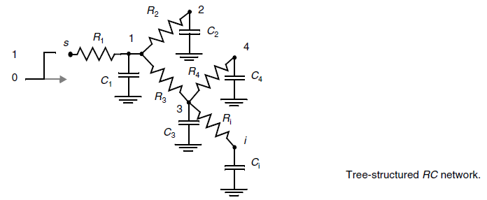
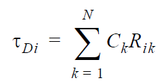
Electrical Wire Models
The Lumped RC Model
A first approach lumps the total wire resistance of each wire segment into one single R and similarly combines the global capacitance into a single capacitor C.
This simple model, called the lumped RC model is pessimistic and inaccurate for long interconnect wires, which are more adequately represented by a distributed rc-model.
For the delay calculation methods such as the Elmore delay formula can be used
The Elmore delay at node i

Slide 14
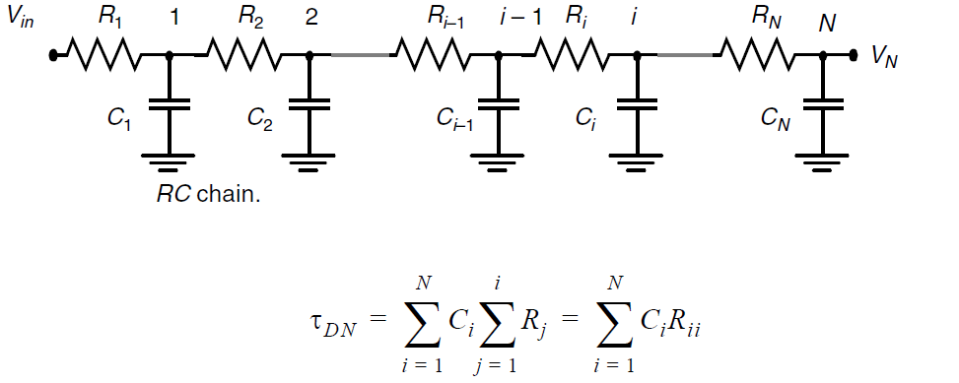
Electrical Wire Models
The Lumped RC Model

Slide 15
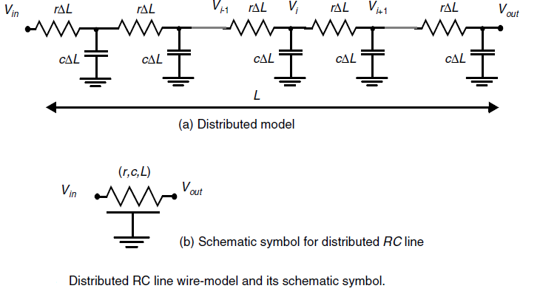
Electrical Wire Models
The Distributed rc Line

Slide 16
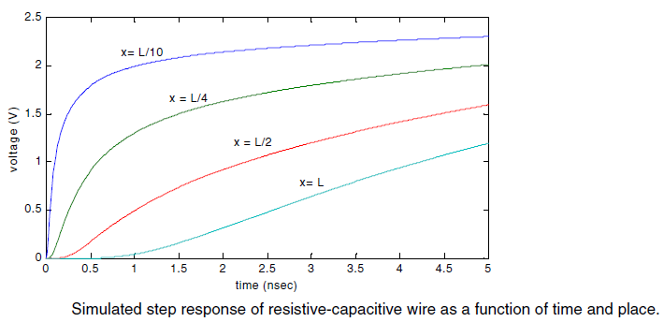
Electrical Wire Models
The Distributed rc Line
The voltage at node i
Solving this equation;

Slide 17
Electrical Wire Models
The Distributed rc Line

Slide 18
Electrical Wire Models
Example
For die sizes between 1 and 2 cm, wires can reach a length of 10 cm and have associated wire capacitances of substantial value. Consider an aluminum wire of 10 cm long and 1 mm wide, routed on the first Aluminum layer. We can compute the value of the total capacitance;

