Slide 1
ECE 424 – Introduction to VLSI Design
Emre Yengel
Department of Electrical and Communication Engineering
Fall 2014

Slide 2
Standard Cell Layout Methodology
Layout
The Design Rules describe:
Minimum width to avoid breaks in a line
Minimum spacing to avoid shorts between lines
Minimum overlap to ensure two layers completely overlap
Unit Transistor
Transistor dimensions are specified by their W/L ratio
For 0.6 μm process, W = 1.2μm and L = 0.6μm
Such a minimum width contacted transistor is called UNIT TRANSISTOR

Slide 3
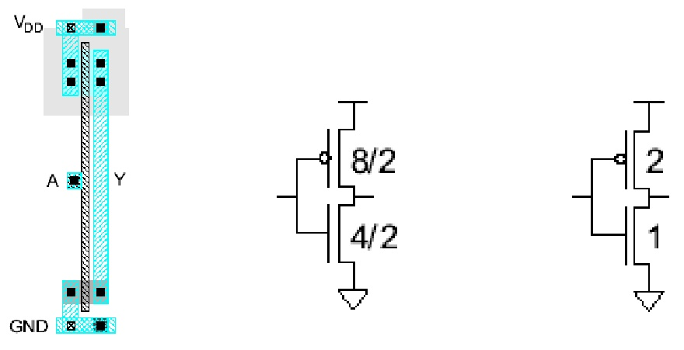
Standard Cell Layout Methodology
Inverter Layout
Transistor dimensions specified as Width / Length
•Minimum size is 4 λ /2λ, sometimes called 1 unit
•For 0.6 mm process, W=1.2μm, L=0.6μm

Slide 4
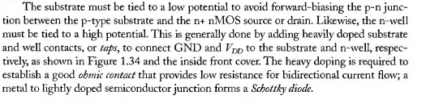
Standard Cell Layout Methodology
Inverter Cross section with well and substrate contacts

Slide 5
Standard Cell Layout Methodology

Slide 6
Standard Cell Layout Methodology

Slide 7
Standard Cell Layout Methodology

Slide 8
Standard Cell Layout Methodology
Layout
A conservative but easy to use Design Rules for n-well process is as follows:
Metal and diffusion have minimum width spacing of 4 λ
Contacts are 2 λ X 2 λ and must be surrounded by 1 λ on the layers above and below
Polysilicon uses a width of 2 λ
Polysilicon overlaps diffusion by 2λ where a transistor is desired and has a spacing of 1 λ away where no transistor is desired
Polysilicon and contacts have a spacing of 3λ from other polysilicon or contacts
N-well surrounds PMOS transistors by 6λ and avoids NMOS transistors by 6λ

Slide 9
Standard Cell Layout Methodology
Rules to get you started;
Simplifed λ based design rules

Slide 10
Standard Cell Layout Methodology
3 Input NAND Standard cell gate layout

Slide 11
Standard Cell Layout Methodology
Well Spacing:
Wells must surround transistors by 6 λ
•Implies 12 λ between opposite transistor flavors
•Leaves room for one wire track

Slide 12
Standard Cell Layout Methodology
A simple method for finding the optimum gate ordering is the Euler-path method: Simply find a Euler path in the pull-down network graph and a Euler path in the pull-up network graph with the identical ordering of input labels, i.e., find a common Euler path for both graphs.
The Euler path is defined as an uninterrupted path that traverses each edge (branch) of the graph exactly once.

Slide 13
Finding an Euler’s Path
Computer Algorithms:
It is relatively easy for a computer to consider all possible arrangements of transistors in search of a suitable Euler path.
This is not so easy for the human designer.
One Human Algorithm
Find a path which passes through all n-transistors exactly once.
Express the path in terms of the gate connections.
Is it possible to follow a similarly labelled path through the p-transistors?
Yes – you’ve succeeded.
No – try again (you may like to try a p path first this time)

Slide 14
Finding an Euler’s Path
Vp
x
Vertex
b
c
x
Edge
a
Out
y
y
c
Vertex
a
b
Gnd

Slide 15
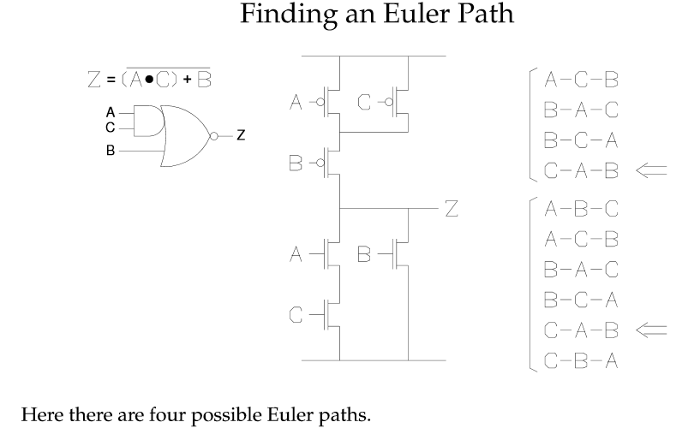
Euler Path

Slide 16
Stick Diagrams
Stick Diagrams (SD)
VLSI design aims to translate circuit concepts onto silicon.
stick diagrams are a means of capturing topography and layer information using simple diagrams.
Stick diagrams convey layer information through colour codes (or monochrome encoding).
Acts as an interface between symbolic circuit and the actual layout.

Slide 17
Stick Diagrams
Stick Diagrams;
Does show all components/vias.
It shows relative placement of components.
Goes one step closer to the layout
Helps plan the layout and routing
Stick Diagrams Does not show
•Exact placement of components
•Transistor sizes
•Wire lengths, wire widths, tub boundaries.
•Any other low level details such as parasitics.

Slide 18
Stick Diagrams
Metal
poly
ndiff
pdiff
Can also draw
in shades of
gray/line style.

Slide 19
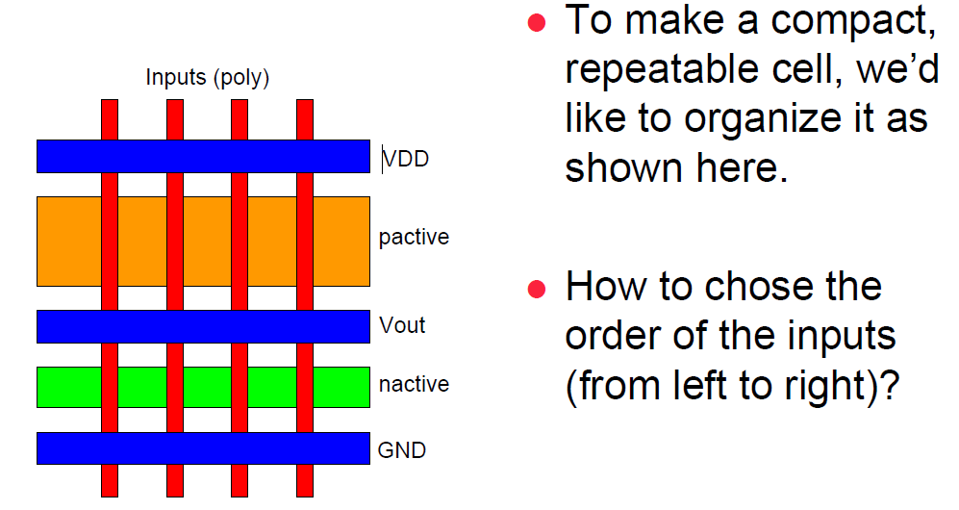
Stick Diagrams

Slide 20
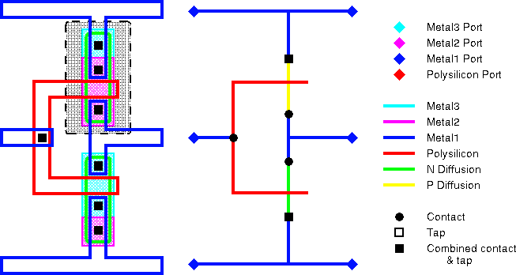
Example

Slide 21
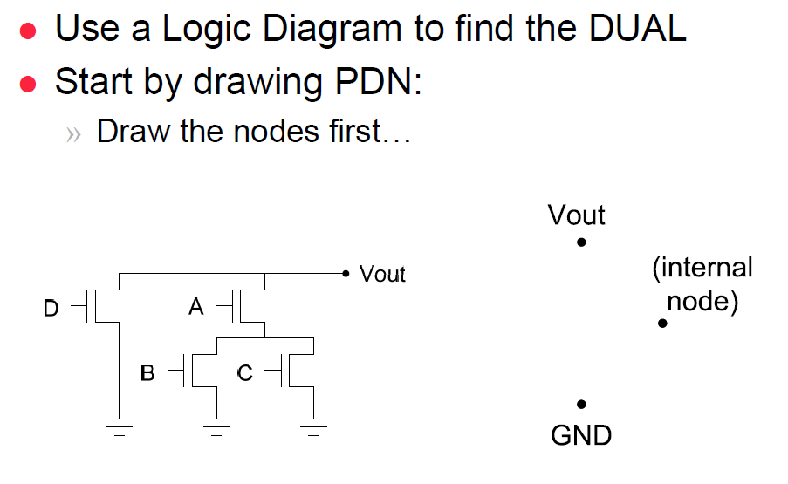
Example

Slide 22
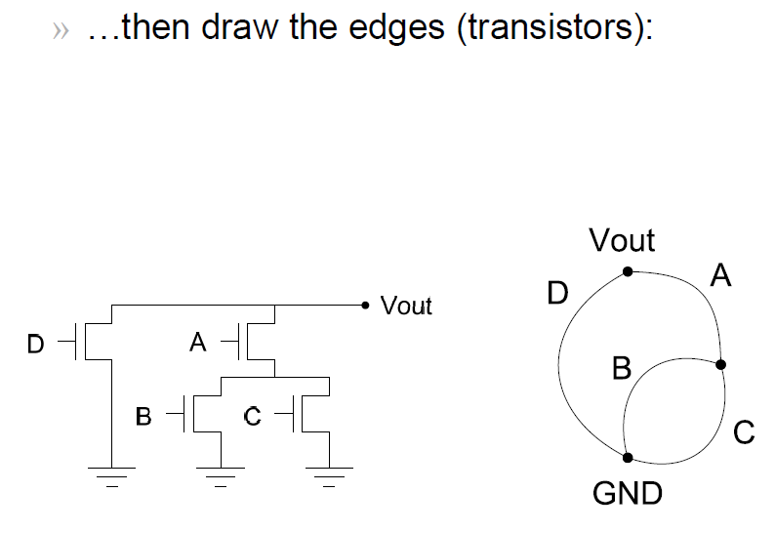
Example

Slide 23
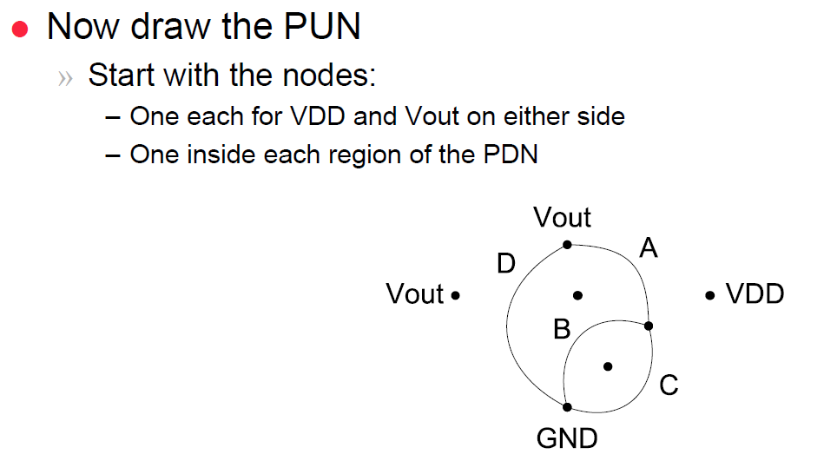
Example

Slide 24
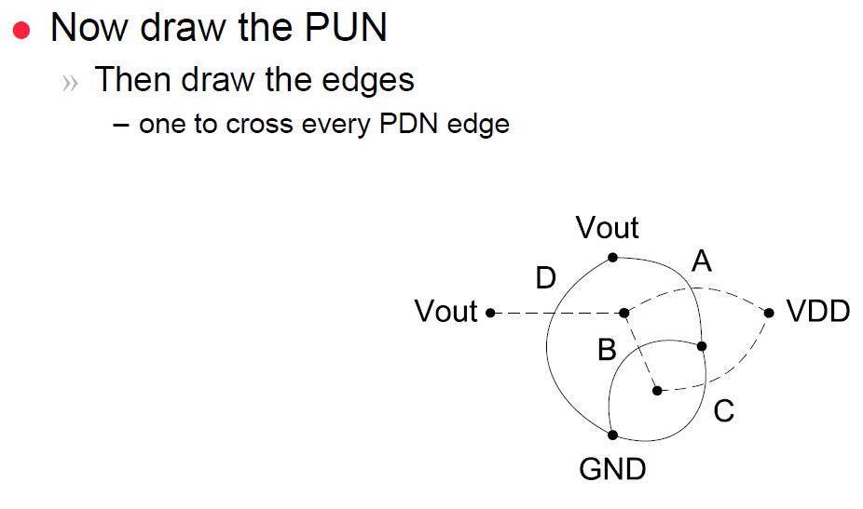
Example

Slide 25
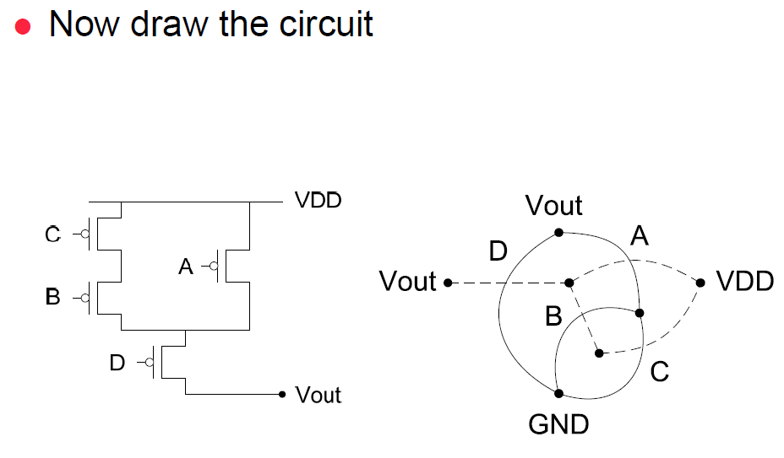
Example

Slide 26
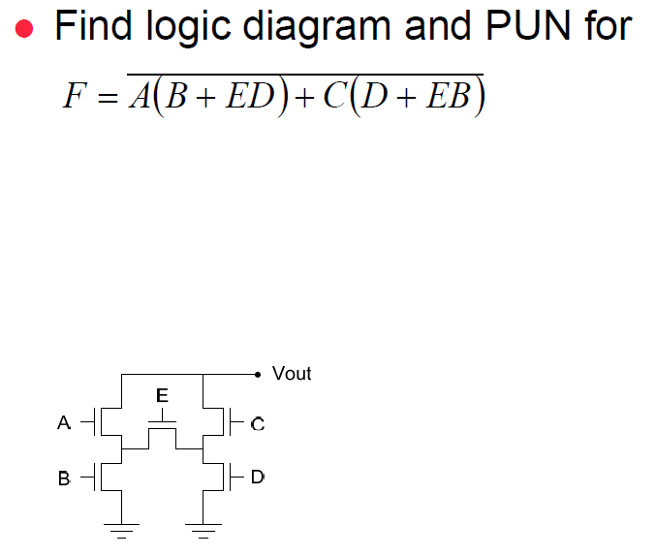
Example

Slide 27
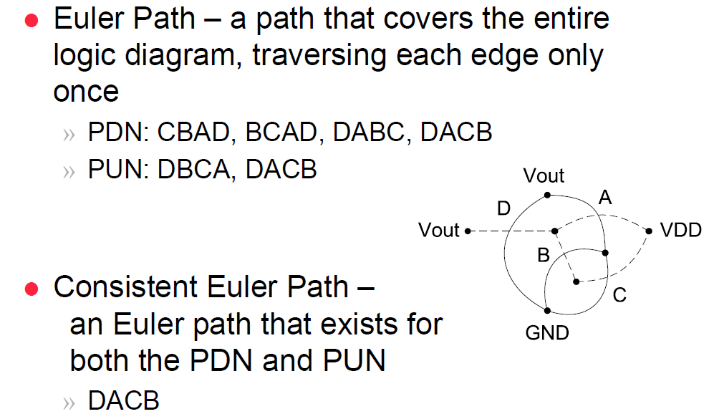
Example

Slide 28
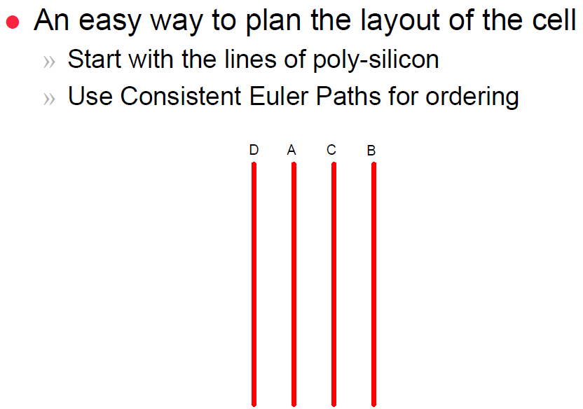
Example

Slide 29
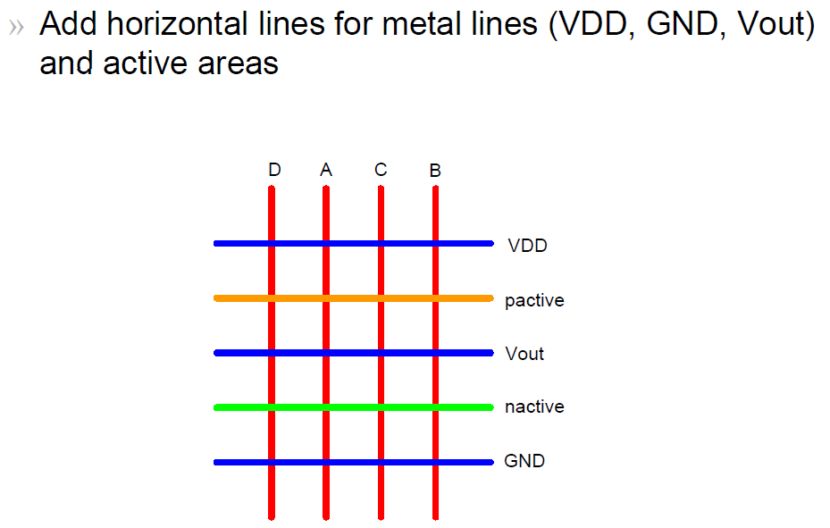
Example

Slide 30
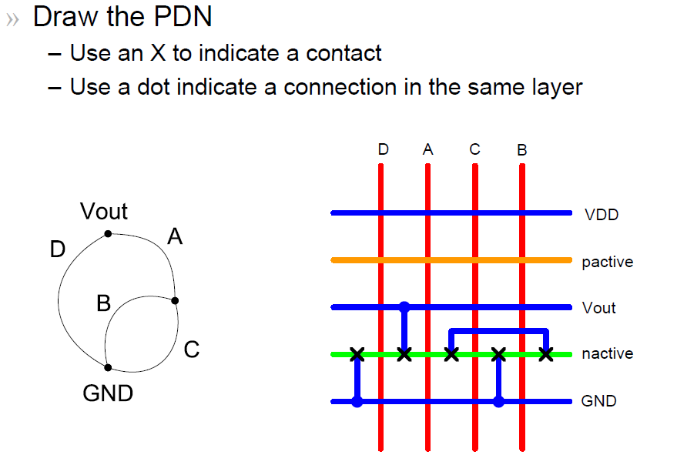
Example

Slide 31
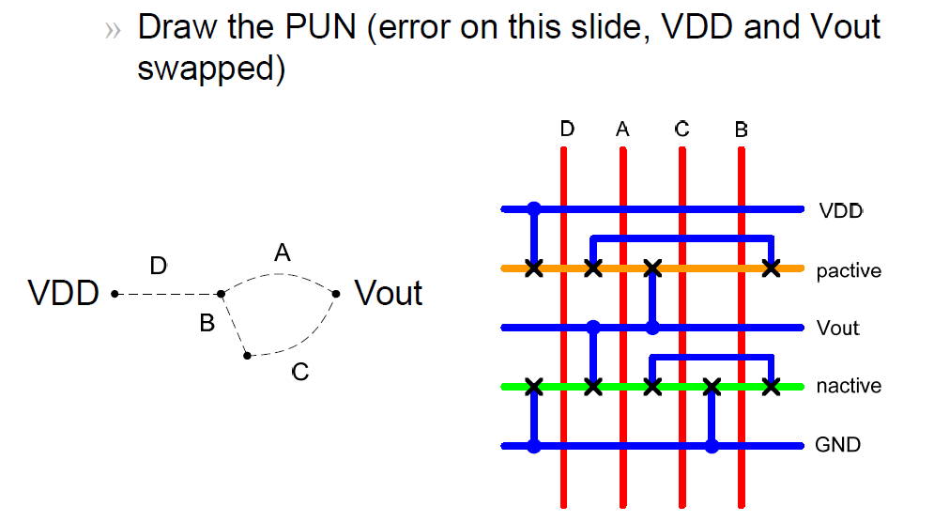
Example

Slide 32
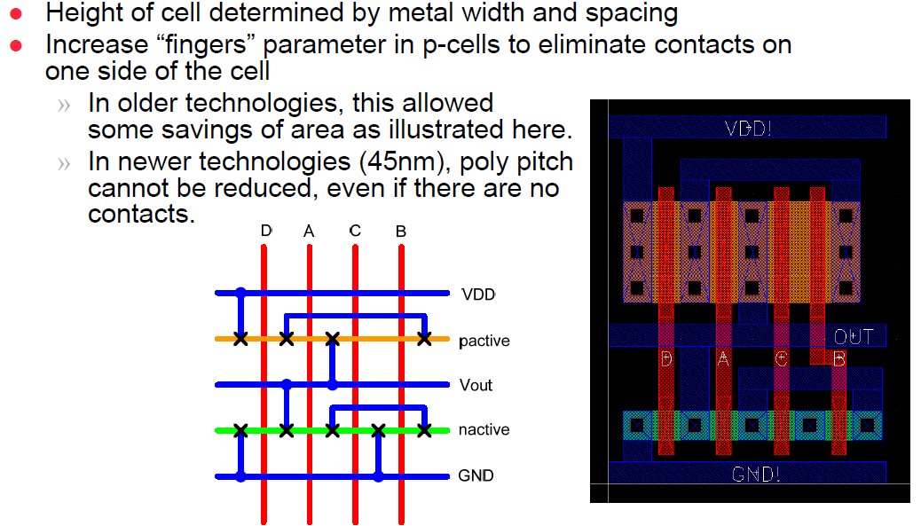
Example

Slide 33
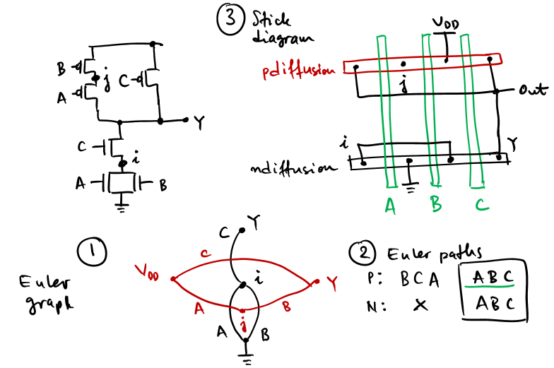
Example 2

Slide 34
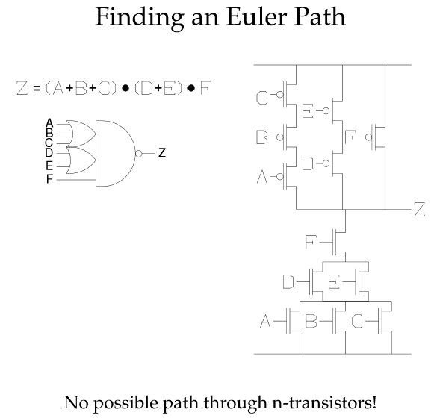
Example 3

Slide 35
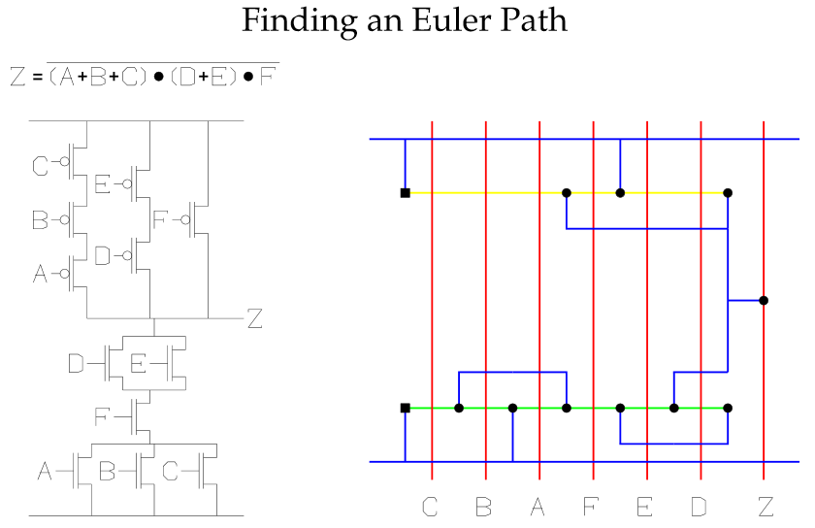
Example 3

