Slide 1
ECE 424 – Introduction to VLSI Design
Emre Yengel
Department of Electrical and Communication Engineering
Fall 2014

Slide 2
Standard Cell Layout Methodology
Application: Frequency division.
Application: Counter (to be covered in Lecture 13.)
High
High
High
J
C
K
J
C
K
QA
J
C
K
QB
Q
CLK
CLK
CLK
CLK
Q
QA
QB
Divide clock frequency by 2.
Divide clock frequency by 4.

Slide 3
Multiplexer Based Latches
Negative latch
(transparent when CLK= 0)
Positive latch
(transparent when CLK= 1)
1
Q
0
Q
D
0
D
1
CLK
CLK
For a negative latch, when the clock signal is low, the input 0 of the multiplexer is selected, and the D input is passed to the output.
When the clock signal is high, the input 1 of the multiplexer is selected.

Slide 4
Multiplexer Based Latches
Transistor-level implementation of a positive latch built by using transmission gates
When CLK is high, the bottom transmission gate is on and the latch is transparent

Slide 5
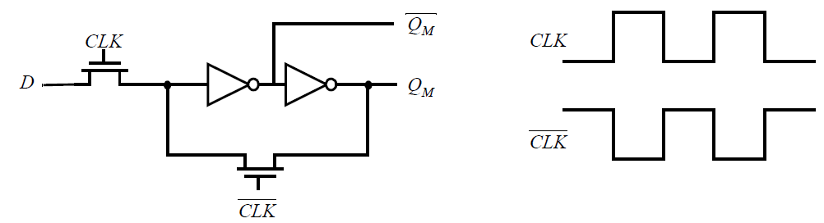
Multiplexer Based Latches
To reduce the clock load to two transistors by using implement multiplexers
using NMOS only pass transistor
The advantage of this approach is the reduced clock load of only two NMOS devices. When CLK is high, the latch samples the D input, while a low clock-signal enables the feedback-loop, and puts the latch in the hold mode.

Slide 6
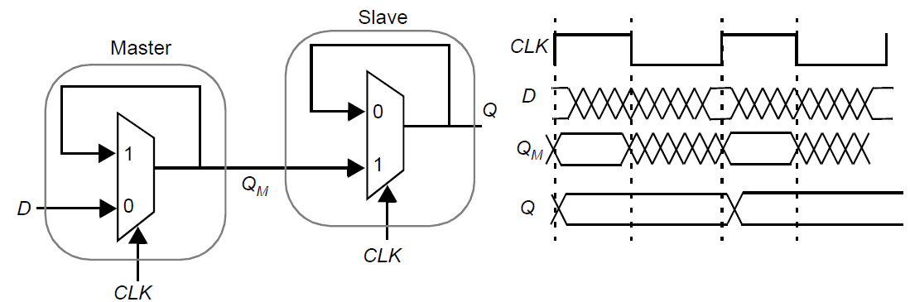
Master-Slave Edge-Triggered Register
The most common approach for constructing an edge-triggered register is to use a masterslave configuration.
On the low phase of the clock, the master stage is transparent, and the D input is passed to the master stage output Q_{M}. During this period, the slave stage is in the hold mode, keeping its previous value using feedback.

Slide 7
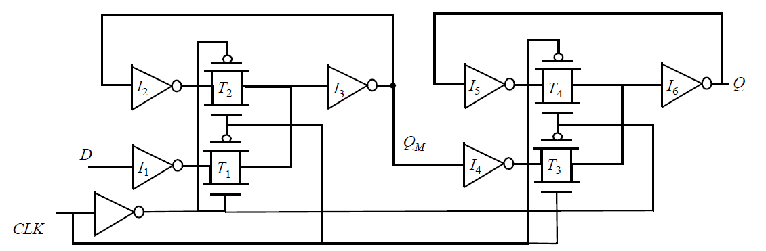
Master-Slave Edge-Triggered Register
A complete transistor-level implementation of a the master-slave positive edge-triggered register

Slide 8
Dynamic Latches and Registers
A stored value in a static sequential circuit remains valid as long as the supply voltage is applied to the circuit, hence the name static.
The major disadvantage of the static gate is its complexity.
When registers are used in computational structures ,the requirement that the memory should hold state for extended periods of time can be significantly relaxed. This is based on temporary storage of charge on parasitic capacitors.
In this idea, the absence of charge denotes a 0, while its presence stands for a stored 1. A stored value can hence only be kept for a limited amount of time, typically in the range of milliseconds.
If one wants to preserve signal integrity, a periodic refresh of its value is necessary. Hence the name dynamic storage.

Slide 9
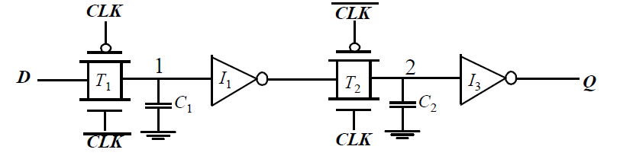
Dynamic Transmission-Gate Edge-triggered Registers
A fully dynamic positive edge-triggered register based on the master-slave concept.
When CLK = 0, the input data is sampled on storage node 1, which has an equivalent capacitance of C₁ consisting of the gate capacitance of I₁, the junction capacitance of T₁, and the overlap gate capacitance of T₁.
During this period, the slave stage is in a hold mode, with node 2 in a high-impedance (floating) state.
On the rising edge of clock, the transmission gate T₂ turns on, and the value sampled on node 1 right before the rising edge propagates to the output Q
This implementation of an edge-triggered register is very efficient as it requires only 8 transistors.

Slide 10

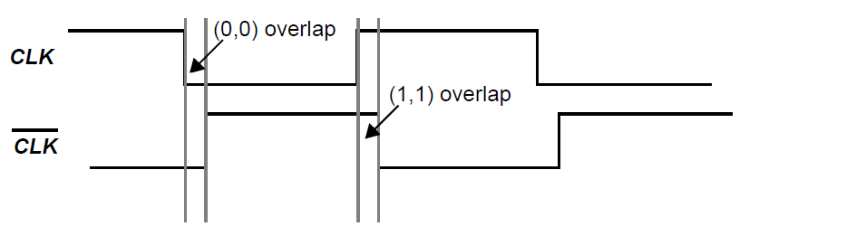

Dynamic Transmission-Gate Edge-triggered Registers
Clock overlap is an important concern for this register. During the 0-0 overlap period, the NMOS of T₁ and the PMOS of T₂ are simultaneously on, creating a direct path for data to flow from the D input of the register to the Q output. This is known as a race condition.
The same is true for the 1-1 overlap region, where an input-output path exists through the PMOS of T₁ and the NMOS of T₂.

Slide 11
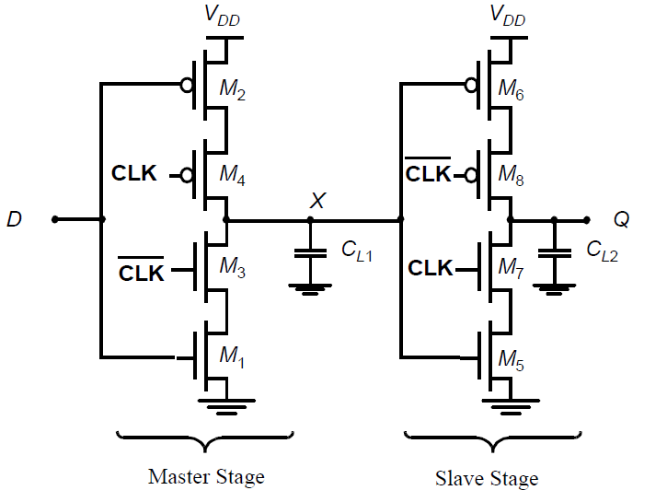
C²MOS Register - A Clock-Skew Insensitive Approach
The circuit is an ingenious positive edge-triggered register, based on a master-slave concept insensitive to clock overlap.
This circuit is called the C²MOS (Clocked CMOS) register

Slide 12
C²MOS Register - A Clock-Skew Insensitive Approach
CLK = 0 (CLK = 1): The first tri-state driver is turned on, and the master stage acts as an inverter sampling the inverted version of D on the internal node X. The master stage is in the evaluation mode. The slave section is in a high-impedance mode, or in a hold mode.
The roles are reversed when CLK = 1: The master stage section is in hold mode (M3-M4 off), while the second section evaluates (M7-M8 on). The value stored on CL1 propagates to the output node through the slave stage which acts as an inverter.
positive edge-triggered master-slave register

Slide 13
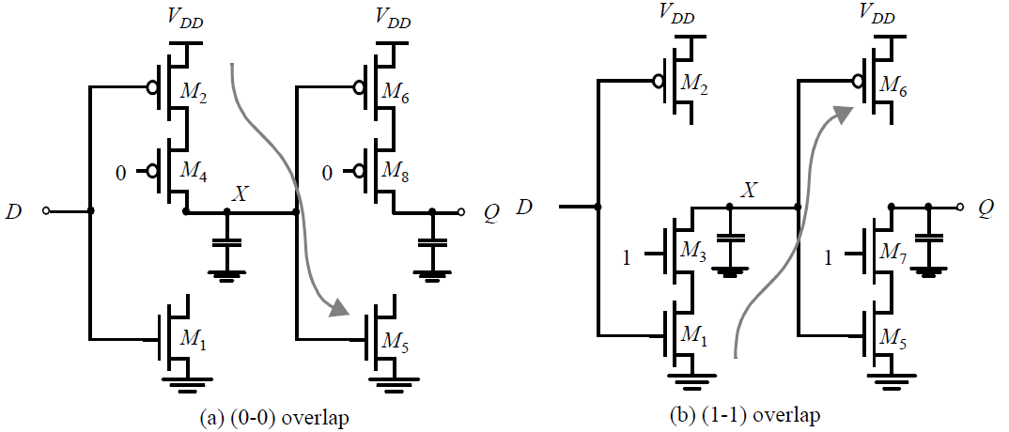
C²MOS Register - A Clock-Skew Insensitive Approach
A C²MOS register with CLK-CLK clocking is insensitive to overlap, as long as the rise and fall times of the clock edges are sufficiently small.

Slide 14
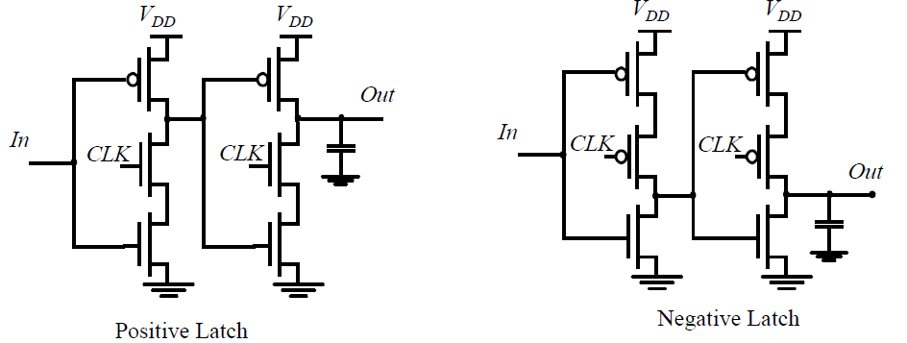
True Single-Phase Clocked Register (TSPCR)
While the C²MOS provides a skew-tolerant solution, it is possible to design registers that only use a single phase clock.
The True Single-Phase Clocked Register (TSPCR), uses a single clock
For the positive latch, when CLK is high, the latch is in the transparent mode. when CLK = 0, both inverters are disabled, and the latch is in hold-mode. Only the pull-up networks are still active, while the pull-down circuits are deactivated.

Slide 15
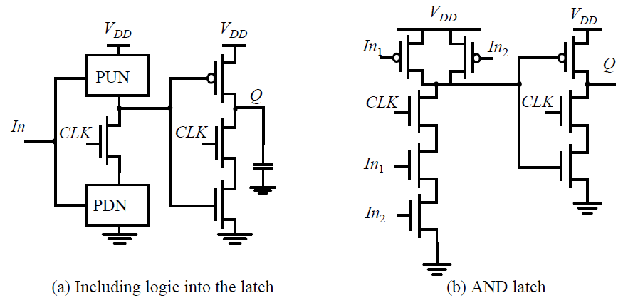
Dynamic Latches
A register can be constructed by cascading positive and negative latches.
The main advantage is the use of a single clock phase.
The disadvantage is the slight increase in the number of transistors — 12 transistors are required.
TSPC offers an additional advantage: the possibility of embedding logic functionality into the latches.

Slide 16
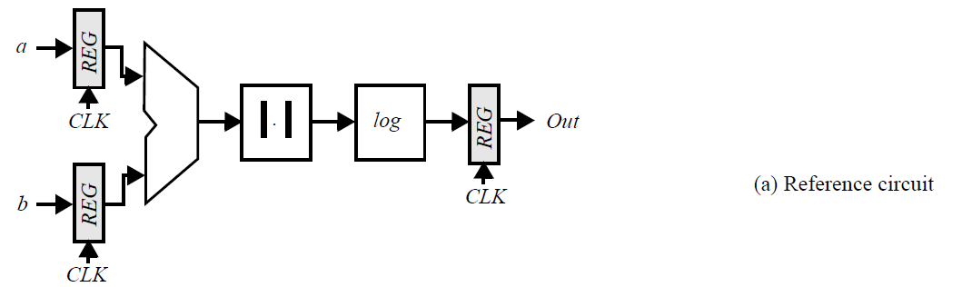

Pipelining: An approach to optimize sequential circuits
Pipelining is used to accelerate the operation of the datapaths in digital processors.
The goal of the presented circuit is to compute log(|a - b|), where both a and b represent streams of numbers.
The minimal clock period T_{min} necessary to ensure correct evaluation is given as:
t_{c-q} and t_{su} are the propagation delay and the set-up time of the register
t_{pd,logic} stands for the worst-case delay path through the combinational network, which consists of the adder, absolute value, and logarithm functions.

Slide 17
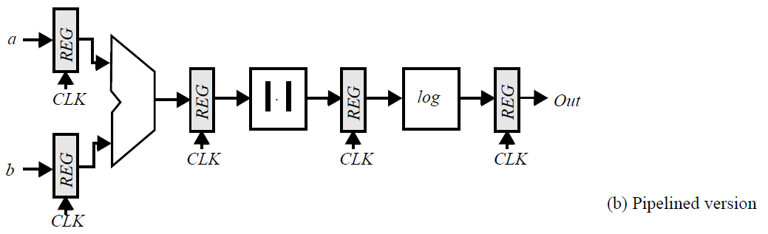
Pipelining: An approach to optimize sequential circuits
Assume that each logic module has an equal propagation delay.
Each logic module is then active for only 1/3 of the clock period, it does no useful computation— during the other 2/3 of the period.
Pipelining is a technique to improve the resource utilization, and increase the functional throughput. Assume that we introduce registers between the logic blocks, as shown below.

Slide 18
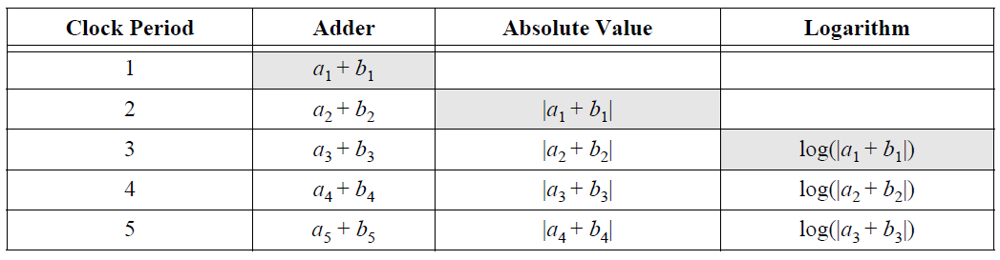

Pipelining: An approach to optimize sequential circuits
This causes the computation for one set of input data to spread over a number of clock periods.
The computation is performed in an assembly-line fashion, hence the name pipeline.
The advantage of pipelined operation becomes apparent when examining the minimum clock period of the modified circuit. The combinational circuit block has been partitioned into three sections, each of which has a smaller propagation delay than the original function. This effectively reduces the value of the minimum allowable clock period:

Slide 19
Non-Bistable Sequential Circuits
The most important property of a latch circuit is that it has two stable states, and is hence called bistable.
Other regenerative circuits can be catalogued as astable and monostable.
Another interesting regenerative circuit is the Schmitt trigger: its switching threshold is variable and depends upon the direction of the transition (low-to-high or high-to-low). This peculiar feature can come in handy in noisy environments.

Slide 20
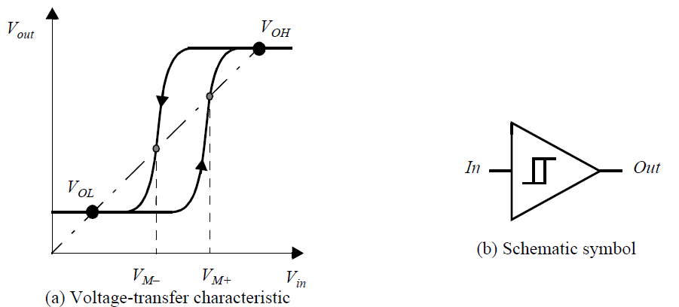
The Schmitt Trigger
A Schmitt trigger is a device with two important properties:
It responds to a slowly changing input waveform with a fast transition time at the output.
The voltage-transfer characteristic of the device displays different switching thresholds for positive- and negative-going input signals. The switching thresholds for the low-to-high and high-to-low transitions are called V_{M+} and V_{M-}, respectively. The hysteresis voltage is defined as the difference between the two.

Slide 21
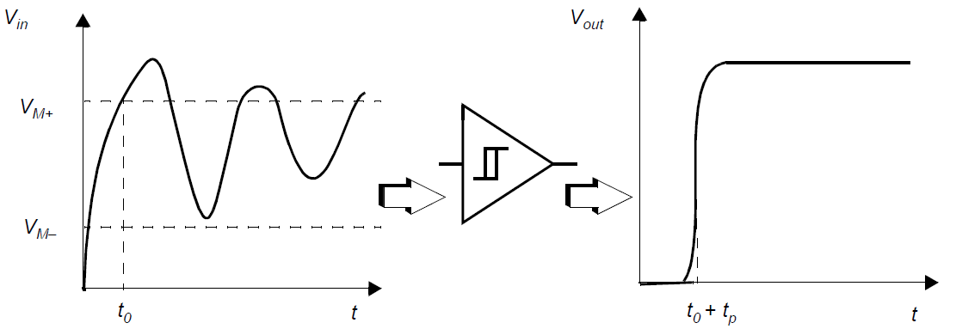
The Schmitt Trigger
One of the main uses of the Schmitt trigger is to turn a noisy or slowly varying input signal into a clean digital output signal.
The “secret” behind the Schmitt trigger concept is the use of positive feedback.

Slide 22
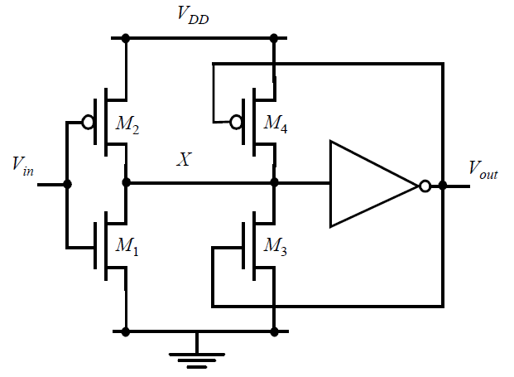

CMOS Implementation of the Schmitt Trigger
One possible CMOS implementation of the Schmitt trigger is shown below:
The switching threshold of a CMOS inverter is determined by the (k_{n}/k_{p}) ratio between the NMOS and PMOS transistors.
Increasing the ratio results in a reduction of the threshold, while decreasing it results in an increase in V_{M}.

Slide 23
CMOS Implementation of the Schmitt Trigger
V_{in} is initially equal to 0, so that V_{out} = 0 as well.
The feedback loop biases the PMOS transistor M₄ in the conductive mode while M₃ is off. The input signal connects to an inverter consisting of two PMOS transistors in parallel (M₂ and M₄) as a pull-up network, and a single NMOS transistor (M₁) in the pull-down chain.
This modifies the effective transistor ratio of the inverter to k_{M1}/(k_{M2}+k_{M4}), which moves the switching threshold upwards.
Once the inverter switches, the feedback loop turns off M₄, and the NMOS device M₃ is activated. This extra pull-down device speeds up the transition and produces a clean output signal with steep slopes.
A similar behavior can be observed for the high-to-low transition. In this case, the pull-down network originally consists of M₁ and M₃ in parallel, while the pull-up network is formed by M₂. This reduces the value of the switching threshold to V_{M–}.

